Slide 1
SDSC 2005 - Introduction to Computational Social Science
Hao PENG
(haopeng@cityu.edu.hk)
Department of Data Science
City University of Hong Kong
https://haoopeng.github.io/

Slide 2
Hao PENG (彭浩)
Assistant Professor
Department of Data Science
College of Computing, CityU
Postdoc: Kellogg School of Management, Northwestern U.
PhD: Information Science, University of Michigan
BS: Information Management, Sun Yat-sen University
Research interests:
Computational Social Science, Social Networks, Science of Innovation, Social Media, Management Science, Complex Systems, Network Science, LLM, NLP, AI, Gender, Diversity

Slide 3
About this course
You will learn core elements of doing computational social science research in online media, marketing, business, politics, policy, etc.
Data collection, computational methodologies
Academic research, industry /domain applications
The main coding environment is Python, R, & Jupyter Notebook
Instructor: PENG Hao
16F-274, AC3
Office hour: Email or by appointment
Teaching assistants
Yuhan TANG: yuhan.tang@my.cityu.edu.hk
Jiajun LIN: jiajunlin4-c@my.cityu.edu.hk
There will be a tutorial (~40 mins) lead by TA after each lecture

Slide 4
Key topics
Data collection (W2)
Descriptive analysis (W3)
EDA and visualization
Prediction models (W4)
Social text analytics (W5 – HW1; W6 and W13: holiday)
Research design (W7)
Regression vs. experimental design
User behavior analytics (W8)
Causal inference (W9 – HW2)
Social network analysis (W10)
Information diffusion, complex contagion, agent-based modeling
Innovation analytics (W11 – HW3; Presentation in W12, 14)
Notes:
Descriptive analysis & visualization

Slide 5
Grading
Take-home assignments: 30%
3 HW in total (each 10%, Gen-AI allowed)
Each HW is due two weeks after release
Group research project: 20%
Each team consists of 4-5 students
Project proposal (2%, 1-2 pages)
Final paper report (8%, 8-10 pages)
Group presentation (10%, ~20 mins)
Final exam: 50%
Close-book written test
CheatSheet allowed (5 double-sided A4 papers)

Slide 6
Group project (teamwork)
Form/join your team on Canvas –> People –> CSS tab:
Proposal due in Week 8
Study motivation & importance
Dataset & methodologies
Research plan & expectations
final report due at end of semester
Submit presentation slides in Week 12
Presentation (Week 12&14) should contain five sections:
Study context & motivation
Research questions
Data & methods
Key findings & takeaways
Implications & limitations
No free rider: each team member must make meaningful contribution!

Slide 7
Late Policy
Late submission is not graded
1 min late is still late
You can still submit after due date (but no grading)
1 no-penalty late submission allowed
No excuse needed (no need to ask)
Acceptable up to 3 days after due date
Can only apply it to a single assignment
Use it wisely (for sick, family issues, etc.)

Slide 8
Original work policy
Unless otherwise specified in an assignment, all submitted work must be your own, original work.
You may discuss approaches with others on individual assignments, but you may not copy code or other work wholesale.
Any excerpt or reference from the work of others must be clearly identified as a quotation, and a proper citation provided.
Any violation of the Department’s policy on Academic Integrity will result in severe penalties, which might range from:
failing an assignment
failing the course
being expelled from the program

Slide 9
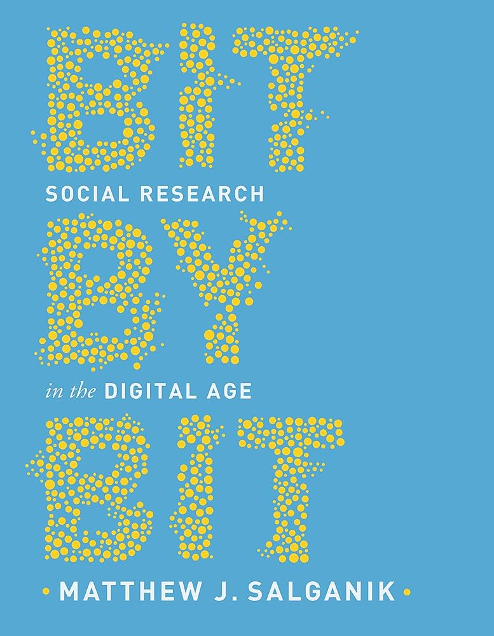
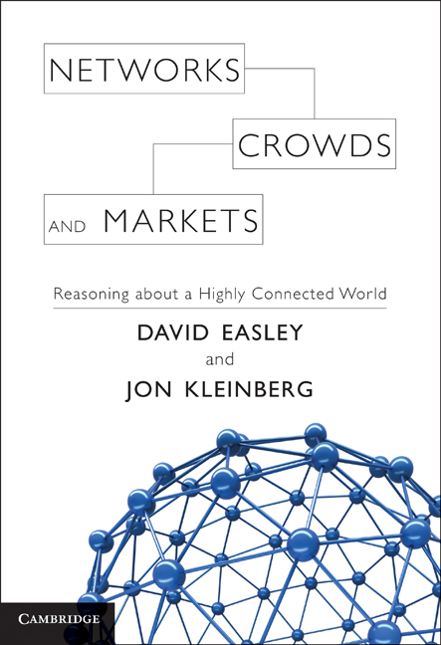

Suggested books
[Bit by Bit: Social Research in the Digital Age]
[Natural Language Processing with Python]
[Networks, Crowds, and Markets]

Slide 10
Questions about class logistics?

Slide 11
Agenda for today
Definition and components of CSS
Overview of research paradigm
Domain applications of CSS
Setup Python and R environment

Slide 12
What is Computational Social Science (CSS)?
Interdisciplinary investigation of the social universe of many scales, ranging from individual actors to the largest groupings, through the medium of computation.] (Cioffi-Revilla, 2014)
The digital age creates new kinds of data, new kinds of methods, and new kinds of questions about society. It does not just make social research faster and cheaper; it makes possible research that was previously unimaginable. (Bit by Bit. Salganik, 2017)
Computational social science studies complex social phenomena by leveraging digital trace data and computational methods that enable new form of measurement & experimentation for theory testing. (ChatGPT 2026)

Slide 13
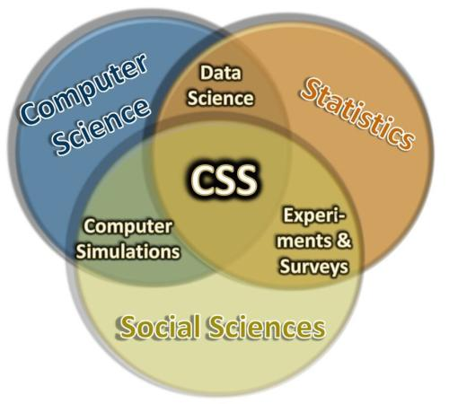
Social Science vs. Computer Sci
Social Science:
people, society, behaviors
understand, explain why & how
policy insights & implications
Computer Science:
models, algorithms, systems
performance & prediction
efficiency > understanding
https://css.ucdavis.edu/about-computational-social-science

Slide 14
Example study: how does influence spread through the social networks
Computer Science (Hard) Approach:
Study: “Efficient Algorithms for Influence Maximization in Graphs”
Problem: Researchers design and test algorithms to identify the smallest set of "seed" nodes in a graph (representing a network) that can maximize the spread of influence under models like Independent Cascade Model or Linear Threshold Model.
Methods: Mathematical proofs, simulations, and complexity analysis (e.g., NP-hardness). The study might simulate random graphs or use real-world / synthetic data to evaluate algorithm performance in terms of speed, approximation guarantees, and scalability for large networks (e.g., millions of nodes).
Key Difference: This is about building computational tools that could apply to any network (social or otherwise). This paradigm prioritizes efficiency over understanding human behavior.

Slide 15
Example study: how does influence spread through the social networks
Social Science (Soft) Approach:
Study: “The Role of Peer Pressure in Adoption of Health Behaviors”
Problem: Researchers conduct surveys or longitudinal studies on a group of people (e.g., 500 participants in a community) to examine how social ties influence behaviors like adopting a new diet.
Findings: The study might be able to find that close friends exert more influence than distant acquaintances, linking this to theories of social capital or diffusion of innovations.
Methods: Surveys, interviews, statistical regression, or controlled experiments. Data is collected ethically from real humans, with attention to variables like demographics, culture, and ethics.
Key Difference: The emphasis is on interpreting human motivations and societal implications, not on computational scale. Results could inform policy or theory but may not generalize to massive datasets.

Slide 16
Example study: how does influence spread through the social networks
CSS Approach (the cool way):
Study: “Mapping Influence Cascades in Social Media During Elections”
Problem: Researchers analyze millions of tweets from platforms like X (formerly Twitter) to model how political opinions spread. They can use network algorithms to identify influential users and machine learning to detect sentiment, revealing how misinformation amplifies through echo chambers and predicting voter turnout in real-time.
Methods: Big data processing skills (e.g., via Hadoop or Python libraries), natural language processing (NLP), simulation, graph algorithms, and statistical modeling on real-world datasets. Some ethical considerations include anonymization and bias mitigation.
Key Difference: It combines CS tools for handling vast datasets with social science questions about human behavior, enabling large-scale, dynamic insights that neither field could achieve alone (e.g., tracking global trends in hours rather than months).

Slide 17
CSS research paradigm: Computational
Research question and hypothesis generation: Traditional social science is often theory-driven. CSS is often data-driven.
Data collection: digital, (un)structured database vs. survey and interview. [Note: CSS also uses surveys to collect data when digital data is not available].
Sample size: small (100-1000s) vs. large scale (millions).
Methodologies: mostly statistical regressions vs. a variety of latest methods in ML, DM, NLP, LLM, AI, Math, Physics, etc.
Study purpose: focus on exploration/understanding social phenomena vs. finding correlations & making predictions.

Slide 18
Summarizing differences
Aspect | Computer Science (CS) | Social Science (SS) | The Computational Social Science (CSS)
Primary Goal | Develop efficient algorithms and models | Explain human behavior and societal patterns | Use computation to scale social insights
Data Scale | Synthetic or simulated (e.g., abstract graphs) | Small to medium (e.g., hundreds of surveys) | Large-scale datasets (e.g., billions of online interactions)
Methods | Simulations, proofs, optimization | Surveys, experiments, qualitative analysis | Big data analytics, NLP, ML, networks
Output | Tools/software for general use | Theories/policies for human understanding | Data-driven predictions and visualizations
Limitations | Often ignores real human nuances | Hard to scale to global phenomena | Requires CS skills; risks data biases

Slide 19
Core components of CSS
Large social data: explosion of digital trace data in the 21st century. These data contain rich info. about our behaviors.
Computational (CS) tools: all the new methods allowing us to compute & extract social variables of our interest.
Complex systems: mathematical frameworks for modeling the dynamics of human society, organizations, collective & individual behaviors. Agent-based modeling techniques.
Social & Network Science: framework for modeling complex human behaviors as the network of connected agents.
Predictions & Simulations: predicting future from past.
Interdisciplinary: social sciences, math, CS, AI, etc.

Slide 20
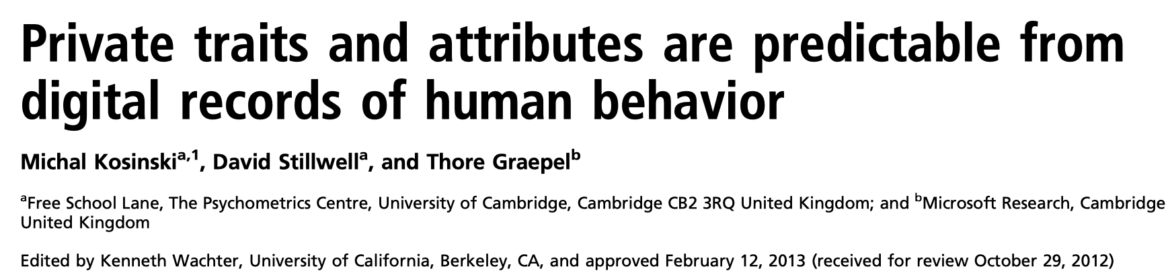
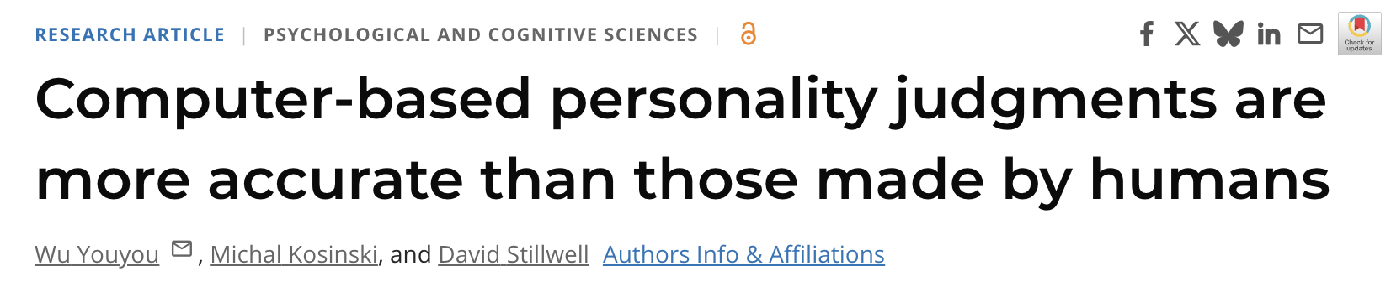
Personality prediction via FB likes
Traditional approach: survey-based psychometric tests
Limitations: slow, costly, small-scale
Notes:
psychology

Slide 21
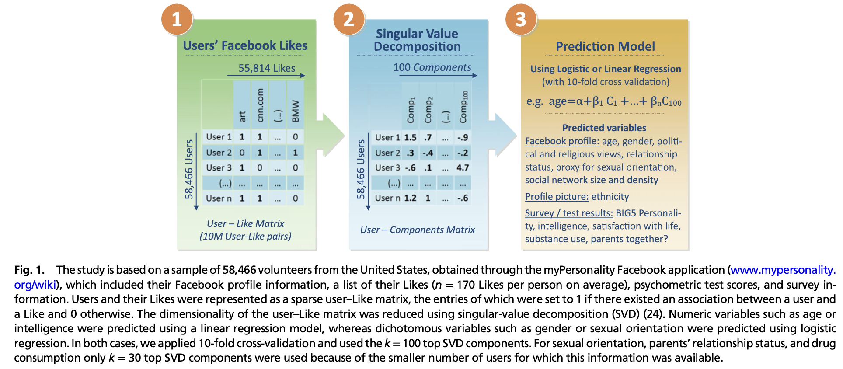
Personality prediction via FB likes
CSS way: use regression models to predict psychological traits
What we will learn: data collection (W2), prediction models (W4)
Sentiment analysis, emotion prediction, etc.
(Kosinski et al., 2013 PNAS)

Slide 22

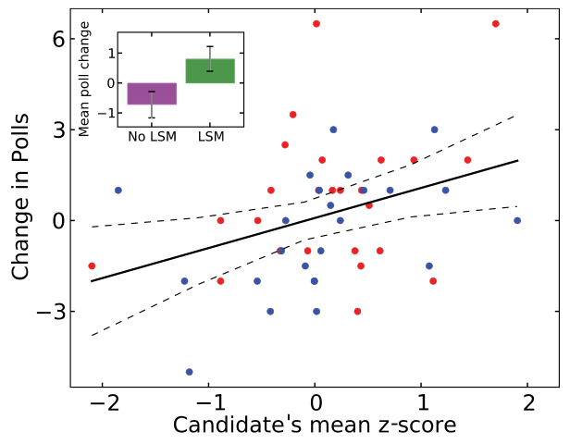
Linguistic analysis in politics
Candidate’s linguistic style in presidential debate can predict poll/election results.
What we will learn:
NLP techniques & models
N-gram, LIWC, w2v, etc.
Fixed-effects regressions
Notes:
politics

Slide 23
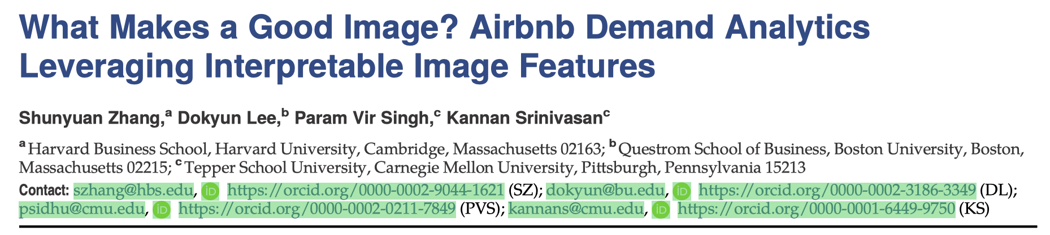
Image analysis in sharing economy
How can we leverage better images to increase Airbnb bookings?
Key findings:
Dataset: images of 7K properties listed in 16 months
veriﬁed images (images taken by host) boost occupancy by 9%
identified 12 attributes that are common signature of verified images
What we will learn:
Observational design, frameworks for quantifying effect size
Causal inference (PSM, DiD), R packages (margins, ggeffects)
Notes:
economics

Slide 24
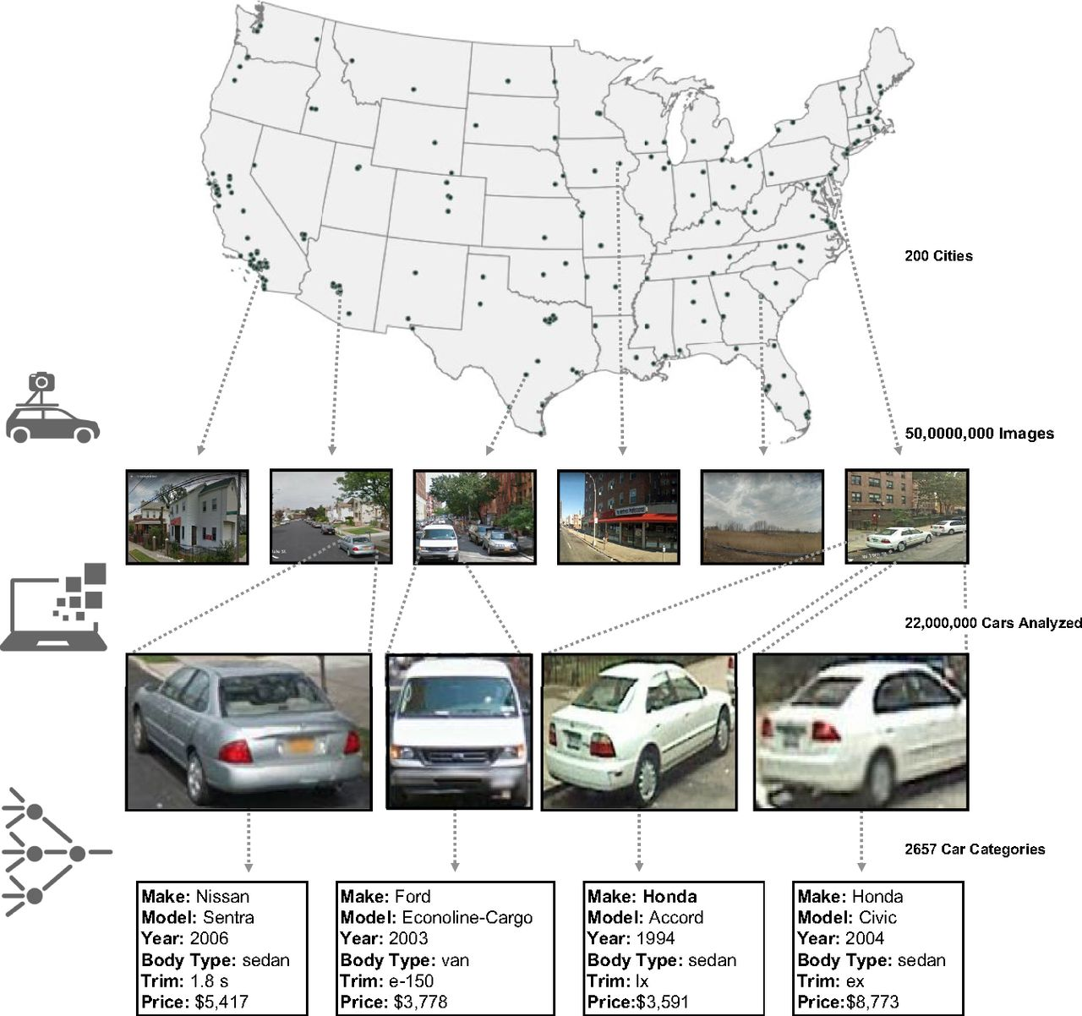
Image-based demographic analysis
Census data collection is time consuming
Data mining methods:
Image features / API
Supervised learning
Classification models
Model assessment
(Gebru et al., 2017, PNAS)
Notes:
sociology

Slide 25
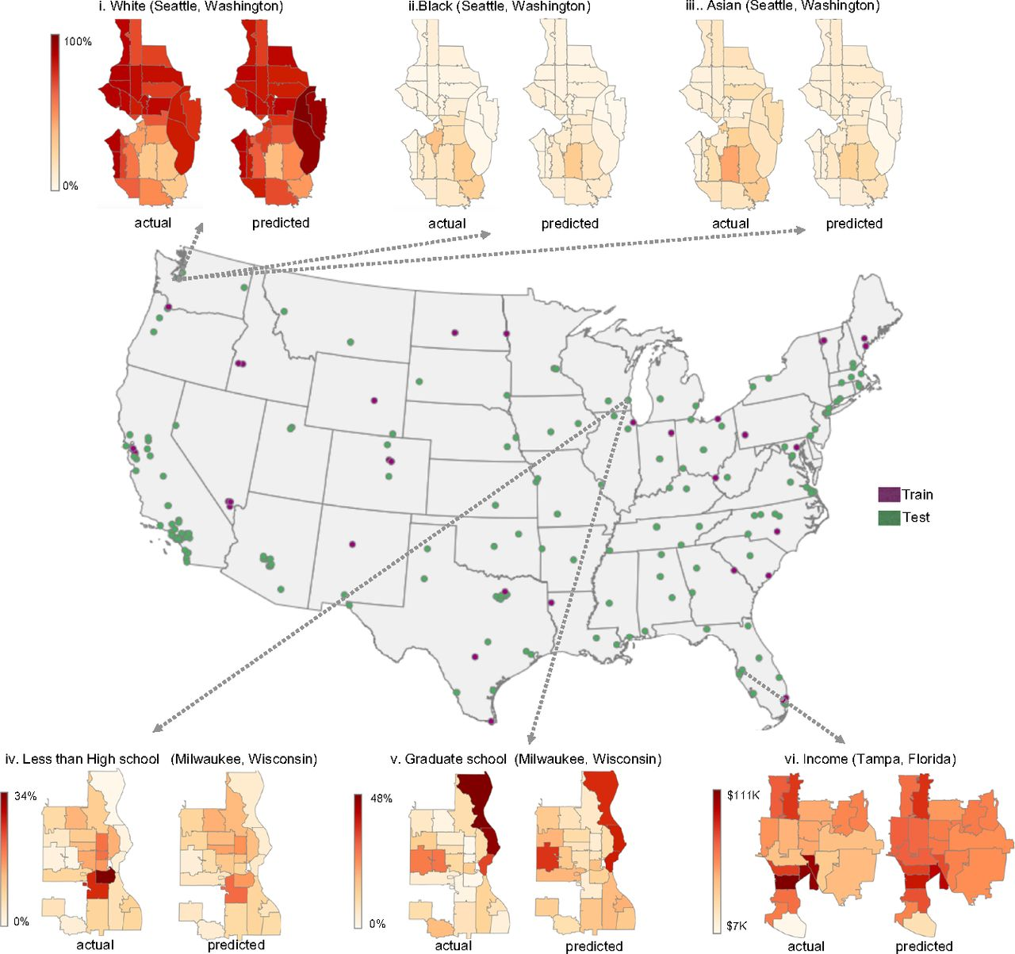
Image-based demographic analysis
Train regression models to predict numerous socioeconomic data from car attributes
The CSS approach gives very good performance
What we will learn:
Predicting user attributes
Gender, age, ethnicity
User engagement & behavior
(Gebru et al., 2017, PNAS)
Notes:
Sociology
Using this model, we estimate demographic variables at the zip code level for all of the cities shown in green.

Slide 26
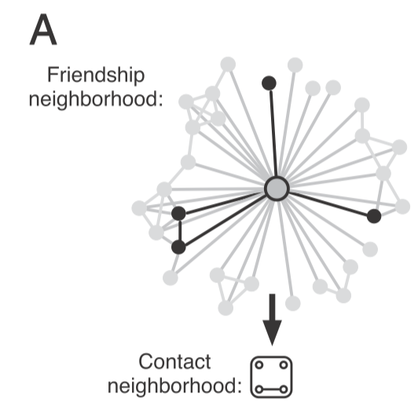
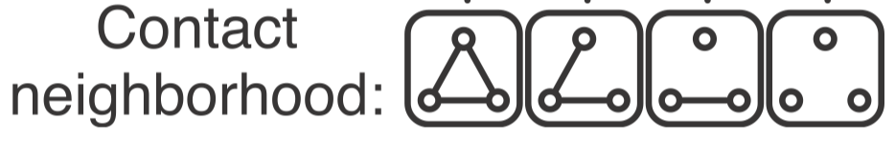

Social media & network analytics
1
1
2
3
1
1
1
1
1
1
Grey links: based on email contacts of FB users (only visible to FB)
Black links: invitations sent by target’s FB friends (visible to target)
Which matters more in predicting the target user joining FB?
num of invitations vs. num of connected components
Ugander et al. PNAS 2012.
Notes:
Social media analysis

Slide 27
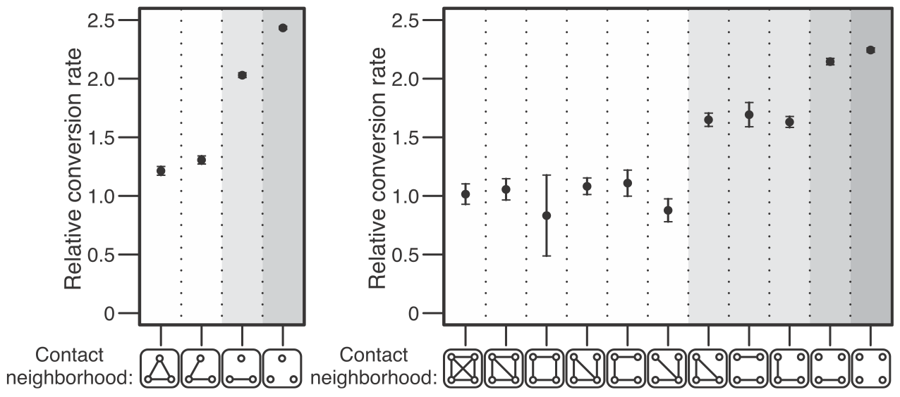
Diversity of connection > size of friends
Network structure of one’s neighbors predicts adoption rates more accurately than the size of one’s neighbors.
What we will learn:
Measures / models of information diffusion (Linear threshold model)
Centrality measures, agent based modeling, simulation, NetworkX

Slide 28
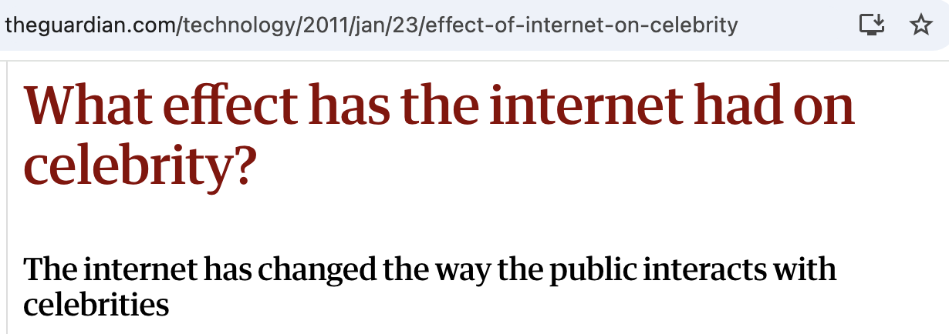

Quality vs. Popularity
The Internet inundates our lives with social influence via numerous quantitative metrics (views, likes; on shopping site, videos, news …)
Notes:
We often hear stories of hit songs, movies, and celebrities that are unusually successful than others.
Are they qualitatively better than others? If so, why do experts often fail to predict successful products?
Every time you access the Internet, you are often surrounded with implicit social influence.

Slide 29
Does quality predict success?
Measure the popularity of 48 songs in an artificial ‘‘music market’’ where all songs start from 0 download with users arriving sequentially at the platform:
Experiment 1:
Social Influence condition:
participants see the previous download count of each song;
the position of each song is randomly shown in the list;
Independent condition:
download count is hidden;
the position of each song is randomly shown in the list;
Experiment 2:
Social Influence condition:
The same as in Exp. 1, with one exception:
songs are ordered by their previous download counts;
Independent condition:
The same as in Exp 1.
(Salganik, Dodds, and Watts. 2006. Science)
Notes:
Cultural analytics

Slide 30
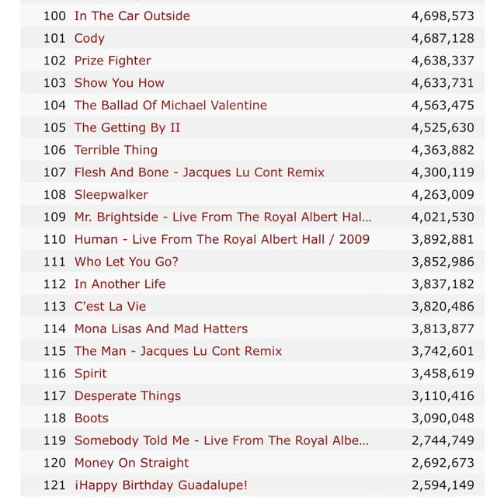
Large-scale online experiment
(Experiment 2)
Social influence condition
(Salganik et al. 2006. Science)
Notes:
Cultural analytics

Slide 31
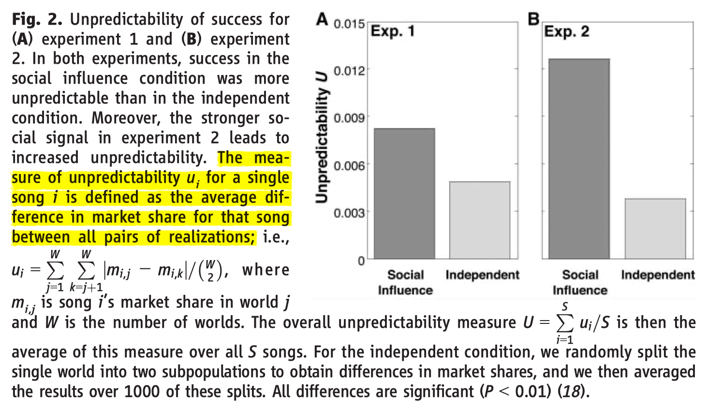
Unpredictability of online popularity
How do we explain a song’s large variation in its popularity?
The “first-mover” effect and luck/randomness.
Notes:
Determined by the first few participants’ preference.

Slide 32
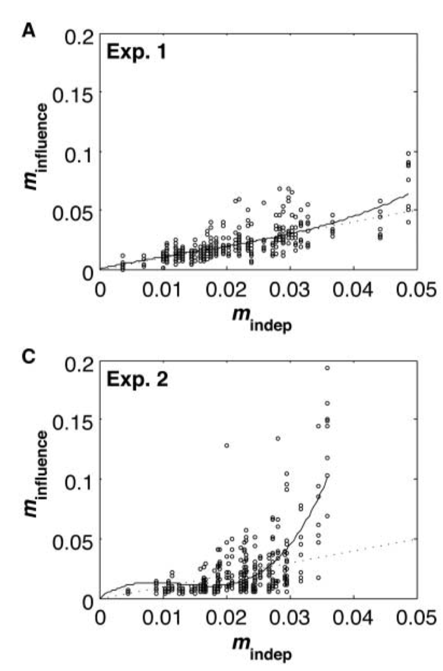
Popularity only partly reflects quality
Use market share in the Ind. condition as a measure of the song’s intrinsic quality.
Popularity under social influence can be much larger than expected based on quality.
What we will learn:
Experimental research design for causal analysis
Crowdsourced platforms
(Salganik et al. 2006. Science)
Notes:
Cultural analytics

Slide 33
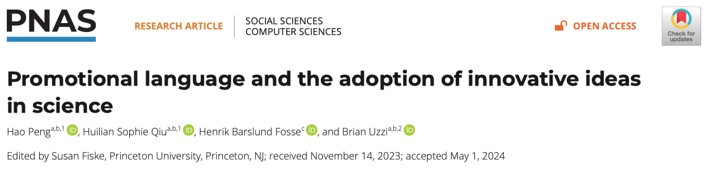
NLP and science policy analysis
Are successful scientific ideas necessarily novel ideas?
What role does writing style play on top of content quality?
Notes:
Scientific innovation

Slide 34
Linguistic communication is key to secure funding & investment
Promo. words (e.g., substantial, key, significant, etc.) boost funding rate.
Perceived quality sometimes can matter more than intrinsic quality.
What we will learn:
Experimental design
Human vs. AI agents
Mediation analysis
Notes:
Scientific innovation

Slide 35
In summary
Computational Social Science paradigm is appliable in many traditional social science domains/studies:
Sociology, Psychology, Economics, Politics, Linguistics
Public policy, health analytics, social media, innovation
Skills we will learn and practice in this course:
Social data collection & manipulation
Correlation and prediction models
Latest NLP models and techniques
Network Science & Complex System tools
Observational and experimental design
Causal inference and mediation analysis

Slide 36
Getting prepared
Setup Python & R programming environment
Install Python and R via Anaconda
Install Jupyter Notebook for interactive coding
Libraries: pandas, matplotlib, mediation, margins, etc.
Tutorial/Practice time
Follow steps to setup computing tools
Consider using virtual environments
Ask us questions to resolve issues

